Slide 1

AIRLINE TICKET BOOKING
Convenient and Hassle-Free Travel

Slide 2

Agenda
Introduction
Features of Airline Ticket Booking
Booking Process
Key Features and Services
Tips for a Smooth Booking Experience
Conclusion

Slide 3
Introduction
This is an Airline Ticket Reservation System Project that was developed using PHP/MySQLi. This ticket reservation system of an airline company serves as the online platform for the Passengers/Customers for booking or reserve their tickets. With the help of this system, the passengers can reserve their flights easily and faster wherever they are. This will help also the Airlines Company to ease the manual system flow and makes their work/process more effective and efficient. The system has 2 types of users which are the Admin and the Customer. The Admin user is in charge of managing the data of the system such as the list of jets, prices, and flight schedules. For the customer, they can simply register to create an account to the system and search if there's an available/scheduled flight for their desired destination and date. After they select their desired flight the system will provide a form to register the details of the passengers and proceeds to payment afterward. The customer can also print/re-print their tickets in the system.

Slide 4
Features of Airline Ticket Booking
One-stop solution: Book flight tickets on a single platform
Easy accessibility: website and mobile app available for booking
Extensive flight options: Multiple airlines, routes, and timings to choose from
Competitive prices: Attractive fares and occasional discounts for users
Integration with railway bookings: Plan seamless travel combining trains and flights

Slide 5
Booking process
This whole passenger side of thing works from the client-side. For booking a flight ticket, the passenger has to select any of the available results. After, the system asks for the passenger’s details such as name, contact, email, and date of birth. The final step of booking an airline ticket includes payment where he/she has to enter card information. And after a successful transaction, the user can view his/her tickets from the tickets section. All the tickets are automatically generated by the system after bookings. In fact, the ticket contains all the flight information such as names of airlines, locations, boarding time, seat, gate number, etc
2023

Slide 6
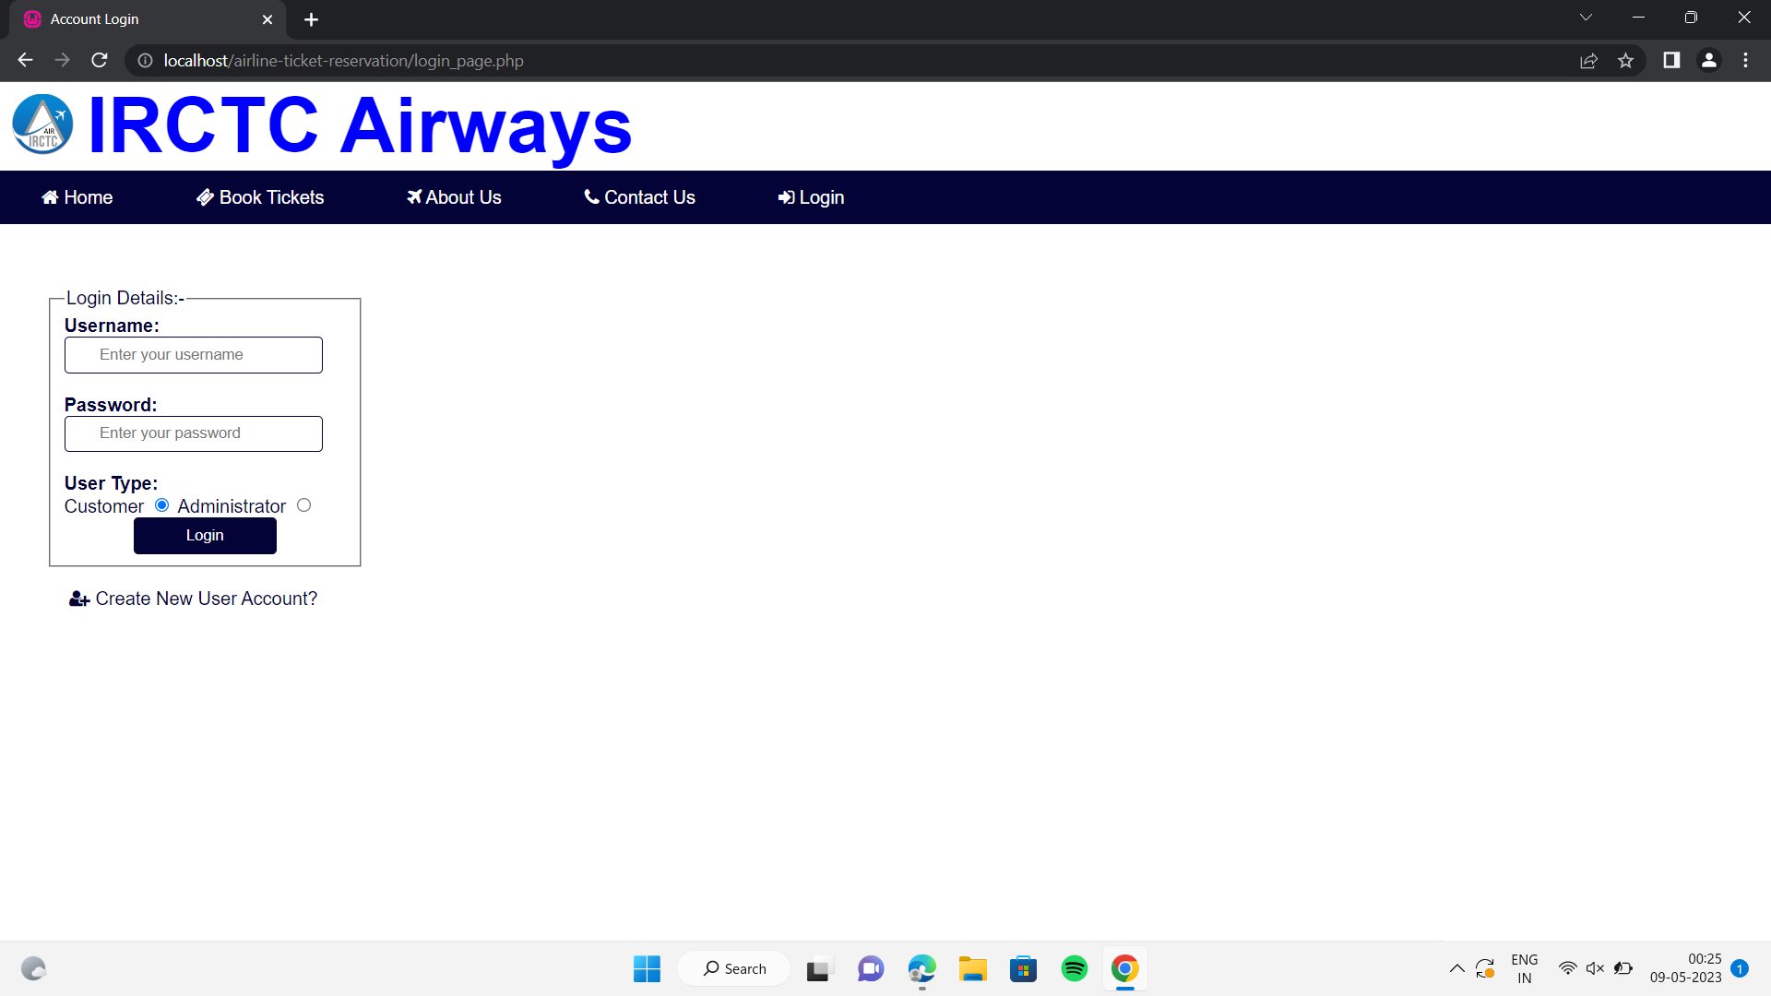
Login details

Slide 7
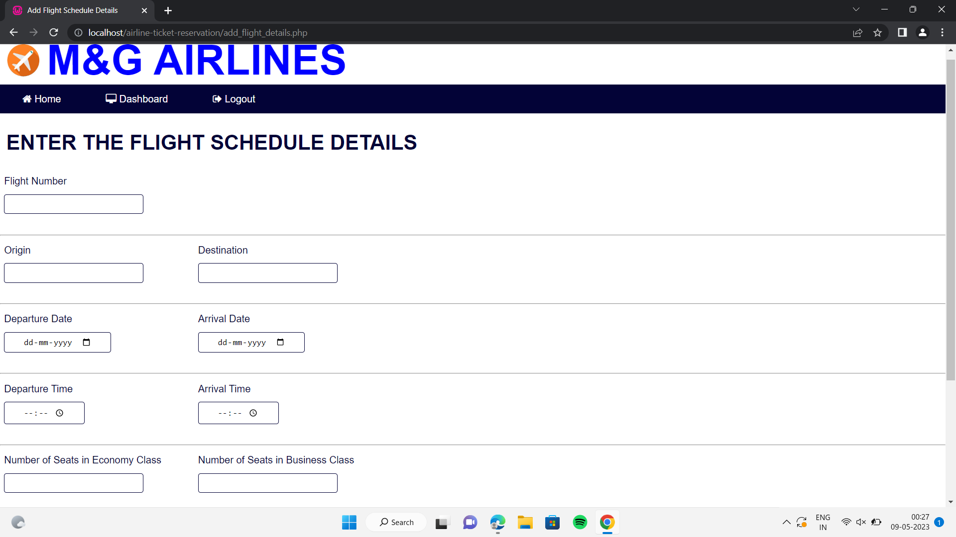
ENTER THE FLIGHT SCHEDULE DETAILS

Slide 8
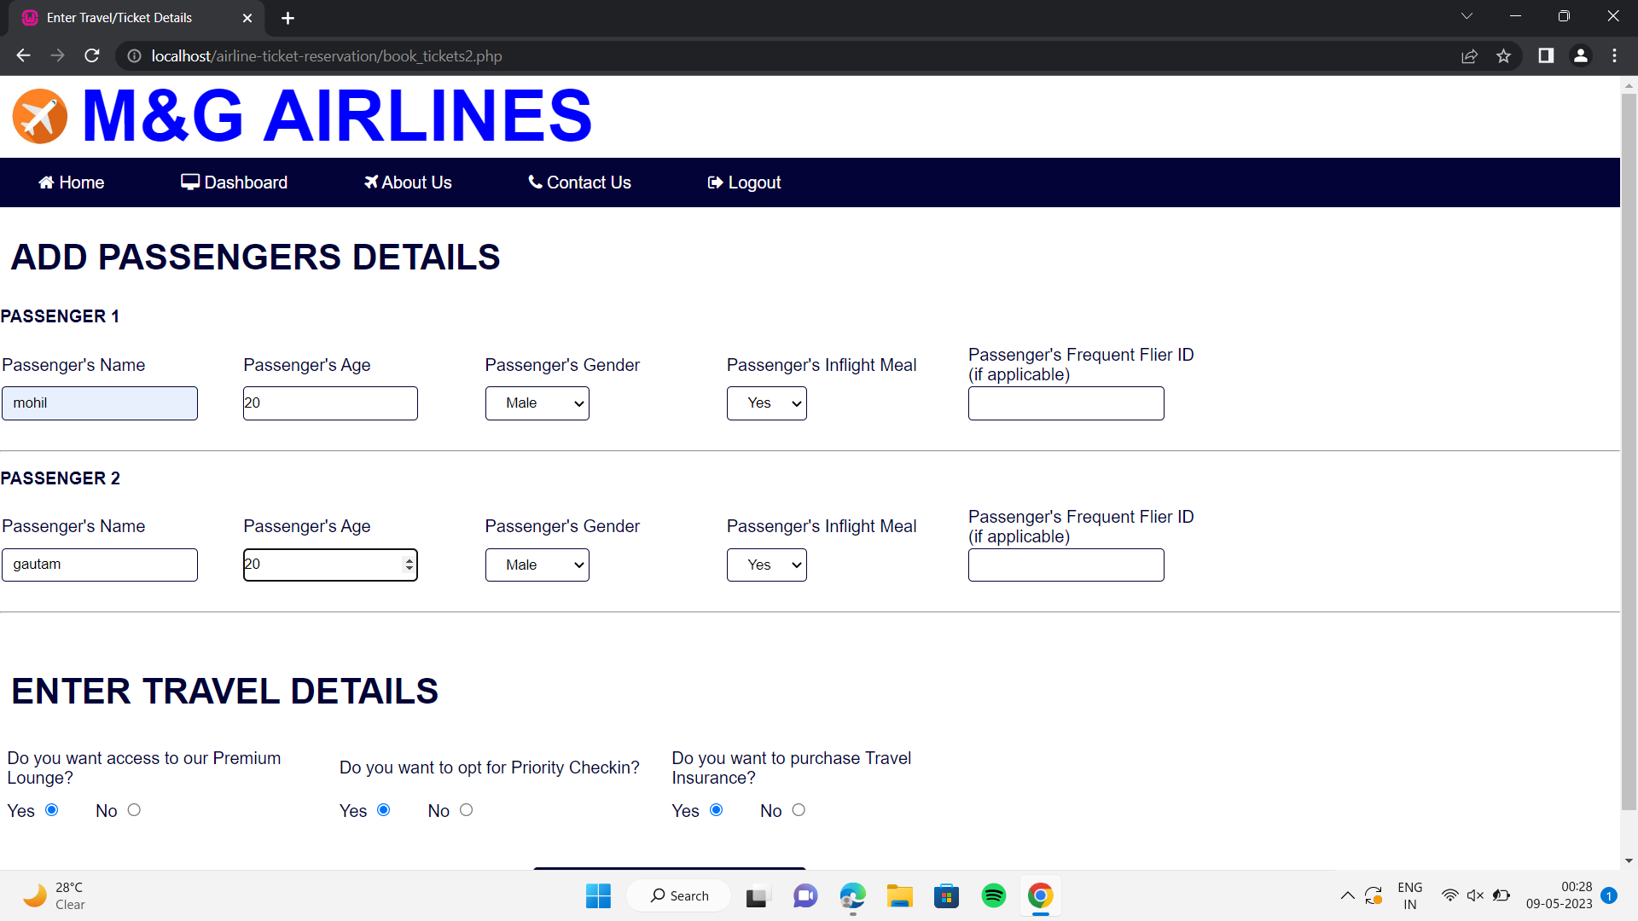
ADD PASSENGERS DETAILS

Slide 9
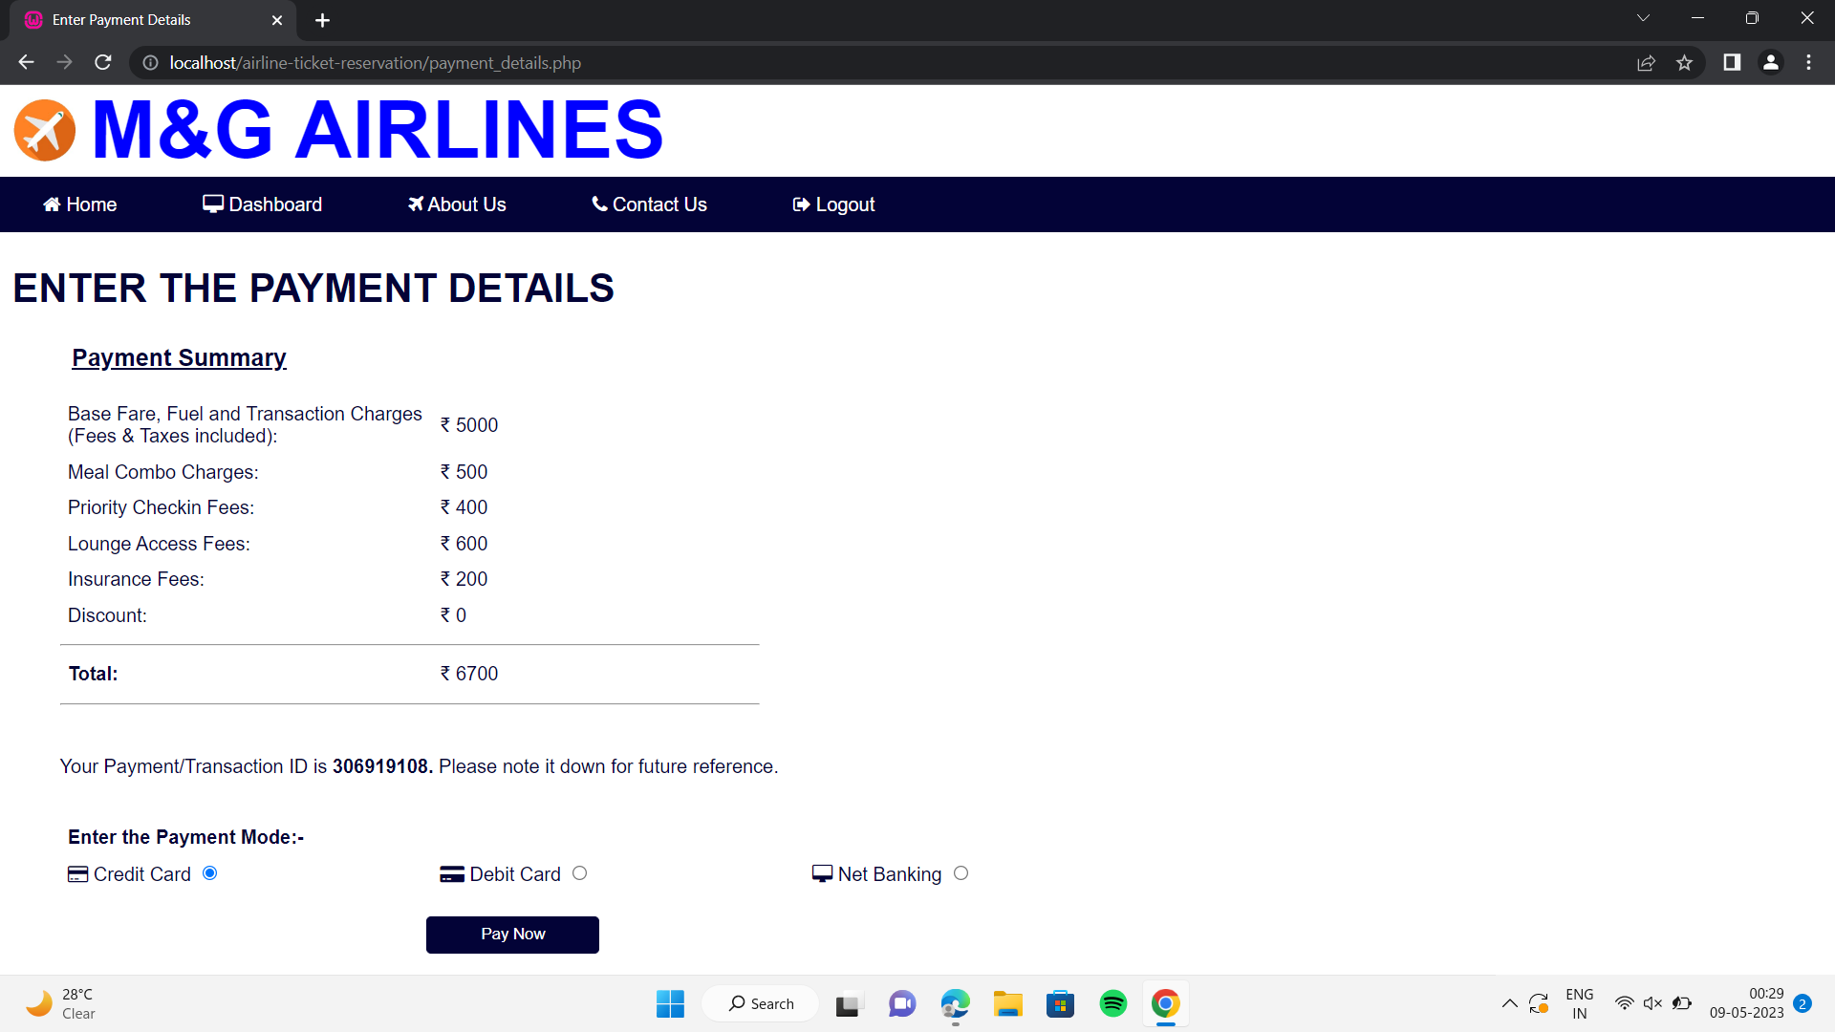
ENTER THE PAYMENT DETAILS

Slide 10
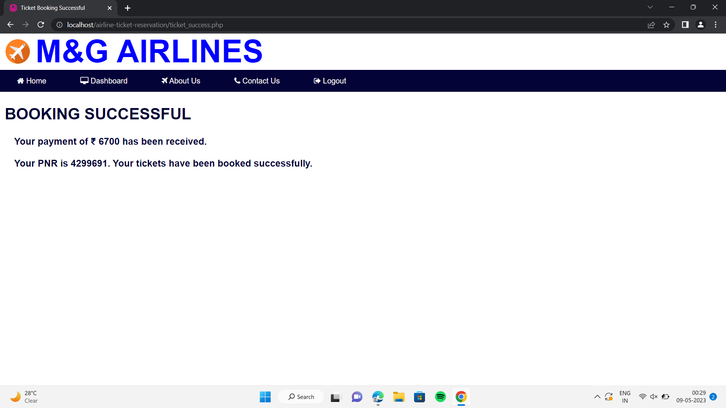
Booking successful

Slide 11
Key features and services
User-friendly interface: Easy navigation and intuitive design
Seat selection: Choose preferred seats during the booking process
Multiple payment options: Convenient payment gateways for secure transactions
24/7 customer support: Dedicated helpline for assistance and query resolution
Cancellation and refund policy: Check terms and conditions for flight cancellations

Slide 12

Conclusion
Expands services to include airline ticket booking, offering a convenient solution for travelers.
With, users can seamlessly plan and book both train and flight journeys on a single platform.
The platform provides a user-friendly interface, extensive flight options, and competitive prices.
Travelers can enjoy the convenience of managing their entire journey in one place.
Reliable services and dedicated customer support ensure a smooth and hassle-free booking experience.

Slide 13

THANK YOU
Gautam Vatiani(200420111056)
Mohil Jain(200420111011)

